Slide 1
CIST 2500
Description
Notes:
This is the beginning of week 2. Welcome!

Slide 2
Admin
Notes:
Not a ton of administration to cover.
This is the first full week and so we’ll be getting to know each other. I’ve taken a ton of the feedback from last semester and used it here. Mostly I was told to:
Abandon the book’s test banks (they were bad and full of mistakes).
Be more purposeful with content (as in, strip it of as much fluff as possible).
Make the homeworks about the act of stats, not the terms.
Give a full week.
_____________________
Is the professor teaching this for the first time? If so, be on guard. We are very human.
Does the promised content match up to the promises (as in, does the stuff like attempts, etc, match up with what was expected?).
Can you find the publisher’s website for the course materials?

Slide 3
Describe
Compare
Relate
Notes:
And so, last Thursday, we mostly all sat here while I tried to talk about the potential of stats, to describe what we’re going to learn and what we’ll be able to do. If you remember, I said stats typically does 3 things.
We describe data, compare things, or relate (correlation, regression models, etc).

Slide 4
Describe
Notes:
So for this week, we’re going to focus on “describing” and that sounds boring but it’s the basic first step we almost always take.

Slide 5
um…what?
Notes:
We really do. We “Describe” our data first or if we are being more direct, we look at the shape of our data in order to verify a few assumptions we have to make.
What are those assumptions?
Our data are normally distributed.
There are no outliers.
What are the modes of central tendency?
How dispersed is the data? (we won’t cover this one today but next week).

Slide 6
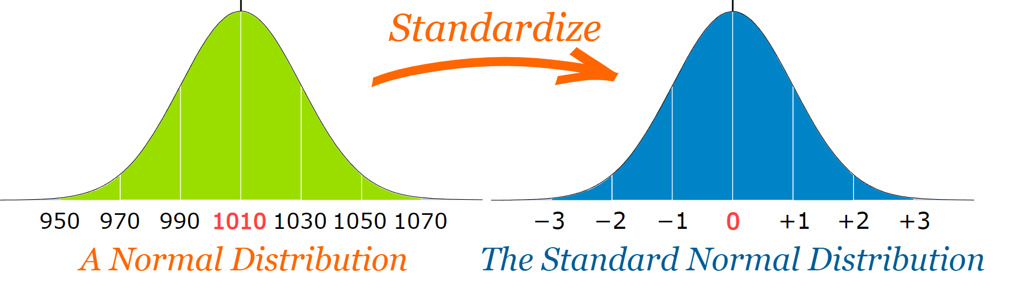
Normal Curve
Notes:
A normal curve is a standardized one.
Consider the following: The SND allows researchers to calculate the probability of randomly obtaining a score from the distribution (i.e. sample). For example, there is a 68% probability of randomly selecting a score between -1 and +1 standard deviations from the mean (see Fig. 4).
Normal distribution could be anything and that’s what makes standardizing so useful.
We just constantly go back to this model to help us make sense of what our data are saying.

Slide 7
where to begin?

Slide 8
population v sample
Notes:
This could be a starting point but let’s hold off on this a bit.
What you should know about this, I’ll cover as it comes up this week.

Slide 9
CENTRAL
TENDENCY
Notes:
The center or typicality of a distribution. The three most common measures of central tendency are mean, median, mode.
This central tendency will have a lot more context once we talk about skewness and kurtosis.

Slide 10
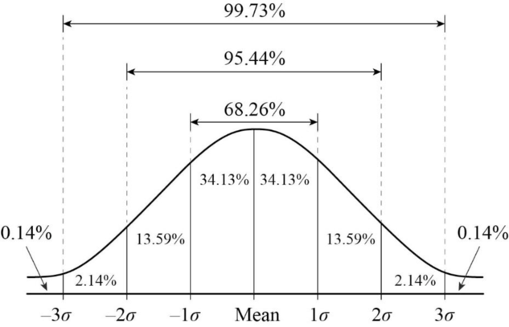
Normal Curve
Notes:
Central Tendency is why this works. We want data to look like this, to be normally distributed.

Slide 11
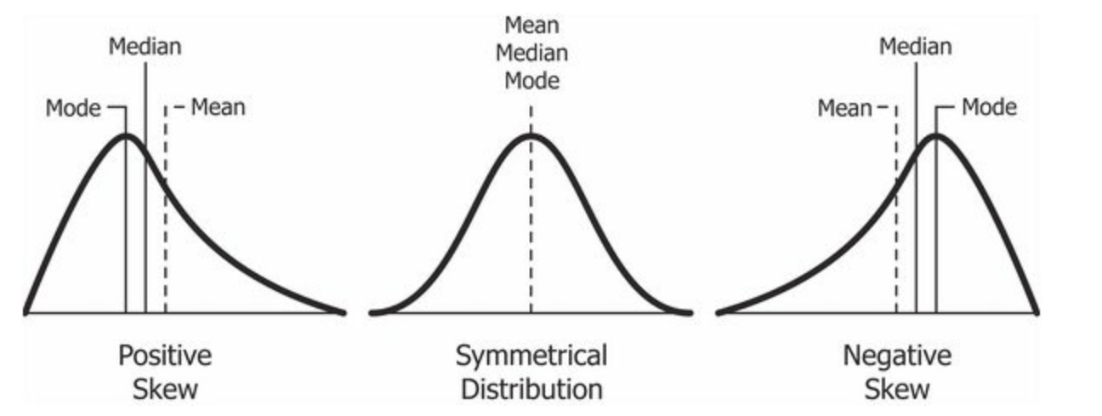
Normal Curve
Notes:
We perform these initial descriptive measures in order to understand if our data looks like this. Mean, Median, and Mode should roughly be the same. We want symmetry.
We’ll get into this at a later date (when we talk about sampling) but I wanted you to know why we’re starting here.

Slide 12
CENTRAL
LIMIT
THEOREM
Notes:
If repeated random samples of size n are taken from a population with a mean or mu and a standard deviation, the sampling distributiuon of sample means will have a mean equal to mu and a standard error equal to standard deviation over the square root of N. Moreover, as n increases the sampling distriubution will approach a normal distribution.
This is a fancy way of saying, “More data means less moves with new data.”
Example: course stuff, GPA, tests, final grades.

Slide 13
Mean, Median, Mode
Notes:
These are the 3 most important and used measures of central tendency. Let’s go through each one. Where appropriate, I’ll introduce you to a few concepts you need to work with.

Slide 14
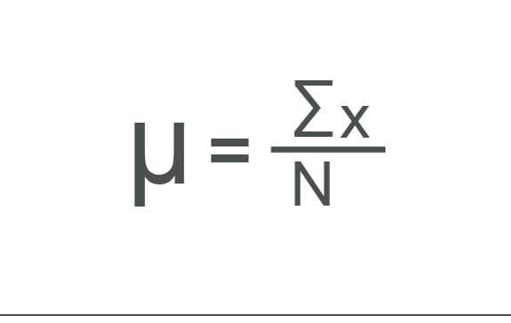
Population Mean
Notes:
Mean, MU is important to understand here.
the average of the sample data that represents the middle of a set of numbers
Mu is when all members of a population can be surveyed.
N is for all population.
n is for sample.

Slide 15
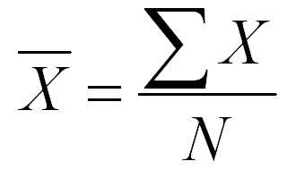
Sample Mean
Notes:
1 1 4 4 4 5 5
vs
1 1 3 4 5 7

Slide 16
Mode
0 1 2 3 4 5 6 7 8 9 10
vs
1 2 3 4 5 6 7 8 9 10
Notes:
When we have no numbers that are repeated more than others, no mode.
Two numbers tied for repeating? Bi-modal.
And so on.
This measure isn’t really about anything more than having a reference for a value that might influence all your data.
Keep in mind that central tendency is mostly allowing you to, at a glance, understand how symmetric your dataset is.
Typically, these should line up but if they do not, your distribution is skewed.
At times, population parameters are skewed as well.

Slide 17
Mode
1 1 4 4 4 5 5
vs
1 1 3 4 5 7
Notes:
1 1 4 4 4 5 5 = 24 || n = 7
vs
1 1 3 4 5 7 = 21 || n = 6

Slide 18
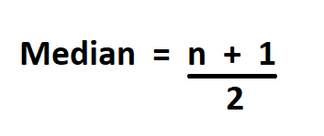
Median
Notes:
Median is the central point of your data. Typically this is a measure of “Position” rather than anything else. You can tell from the formula.

Slide 19
Population Median
0 1 2 3 4 5 6 7 8 9 10
vs
1 2 2 3 4 5 6 7 8 9 10

Slide 20
Population Median
0 1 2 3 4 5 6 7 8 9 10
vs
1 2 2 3 4 5 6 7 8 9 10

Slide 21
other stuff…
Notes:
These are the 3 most important and used measures of central tendency. Let’s go through each one. Where appropriate, I’ll introduce you to a few concepts you need to work with.

Slide 22
Range
Minimum - Maximum
Notes:
What does a range tell us?

Slide 23
Notes:
What does a range tell us?
Well, if we take range, mean, median, mode, and add to it a couple of measures of dispersion (variance and standard deviation), we have everything we need to verify that our dataset is ready to go. We have essentially formed Voltron and can now go on empirical adventures with our sword of analysis.

Slide 24
Deviations
Σ(x-x̄)

Slide 25
Should always = 0

Slide 26
Mean Deviation
(|Σ(x-x̄)|) /n

Slide 27
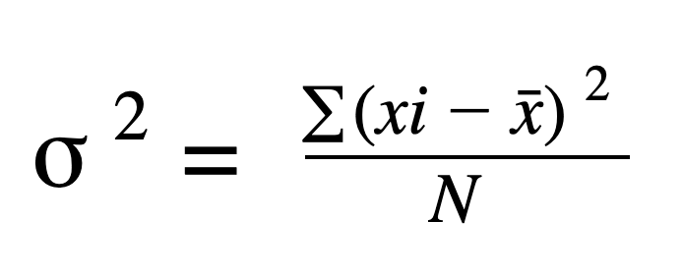
Variance

Slide 28
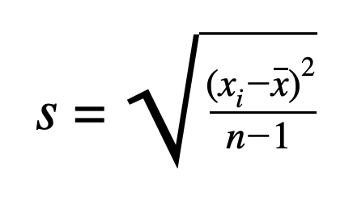
Standard Deviation

Slide 29
N vs N-1
Notes:
use N-1 for samples, and N when population is known.
It essentially increases accuracy
When calculating the std of a sample, they change the n in the demonimator to n-1. This slight reduction in the denominator results in a larger standard deviation. One that better reflects the true standard deviation of the population.

Slide 30
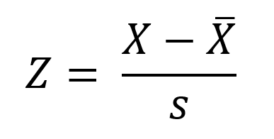
Z-Score
Notes:
The value of the z-score tells you how many standard deviations you are away from the mean. If a z-score is equal to 0, it is on the mean.
There is a table on page 764 with z-scores. Let’s do a few.
It is a composite score.

Slide 31
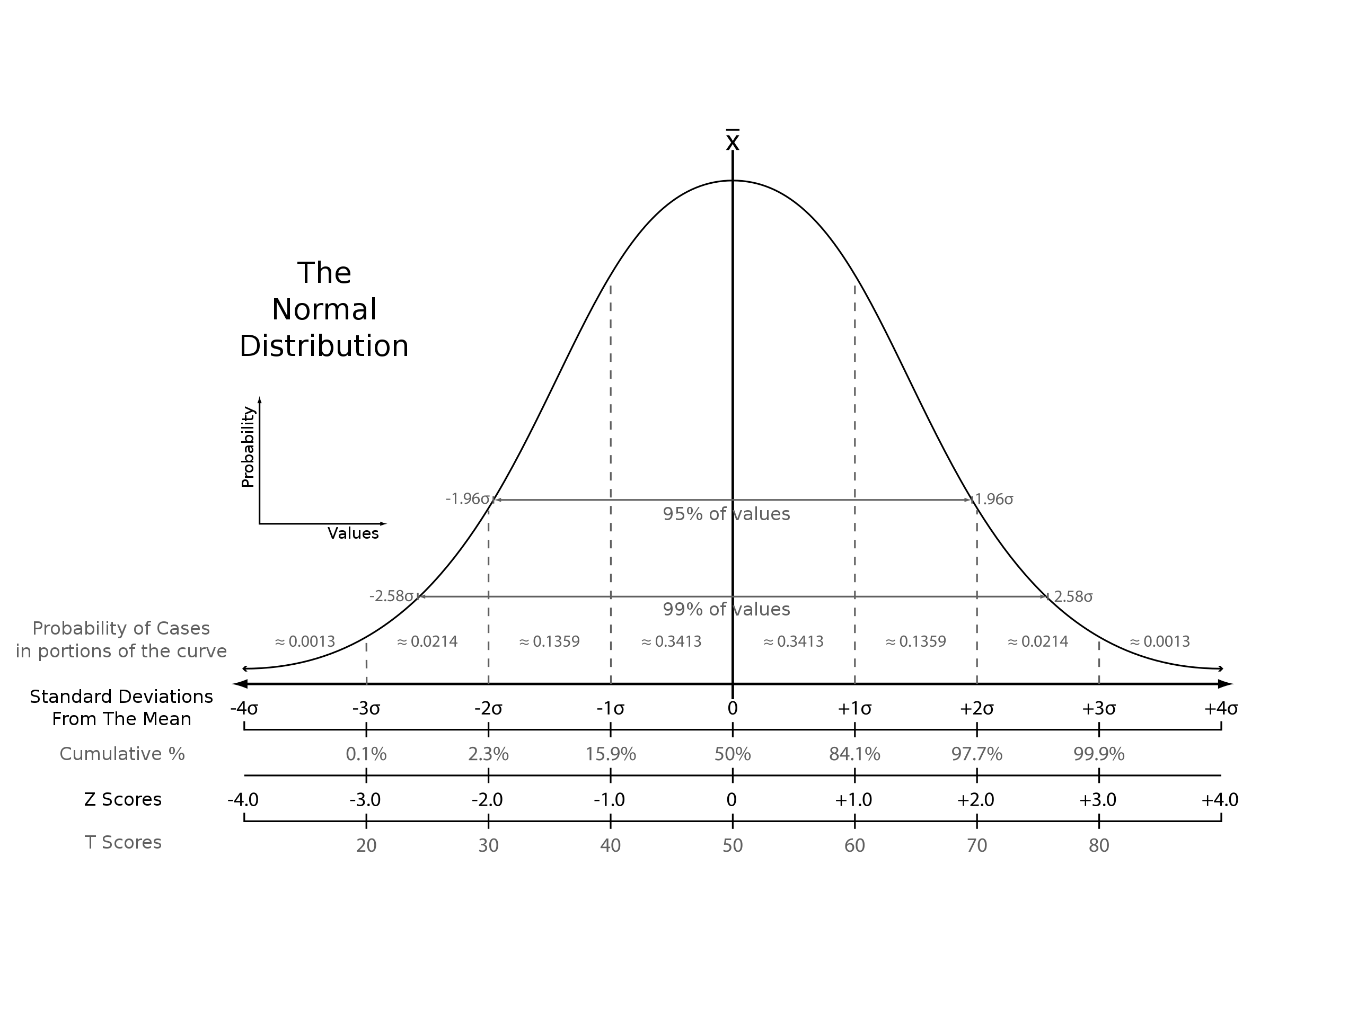
Z-Scores
Notes:
The value of the z-score tells you how many standard deviations you are away from the mean. If a z-score is equal to 0, it is on the mean.

Slide 32
Bring your swords
of analysis thursday
Notes:
I mean computers…

Slide 33
Bye!
Notes:
See you Thursday!!

